Slide 1
Kecerdasan Komputasional
Kelas F

Slide 2
Agenda
Previous Week Assignments
Intro to Machine Learning
k-NN Classifiers
Next Week Assignments

Slide 3
Overview
Pengenalan Supervised Learning
Pengenalan Klasifikasi dengan k-Nearest Neighbour (kNN)
Contoh Dataset
Tugas kNN

Slide 4
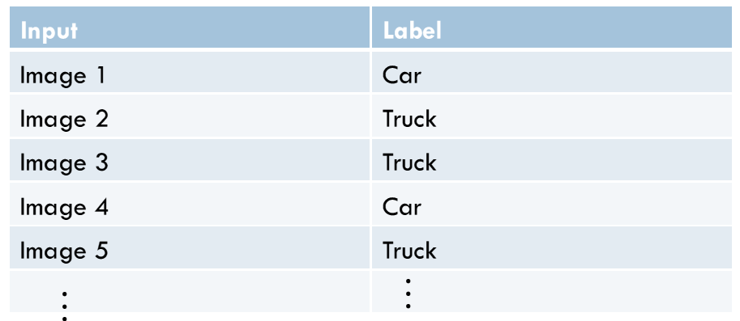
Learning Algorithm TYPES
Supervised
If labelled training data that associates input observations with class labels are available

Slide 5
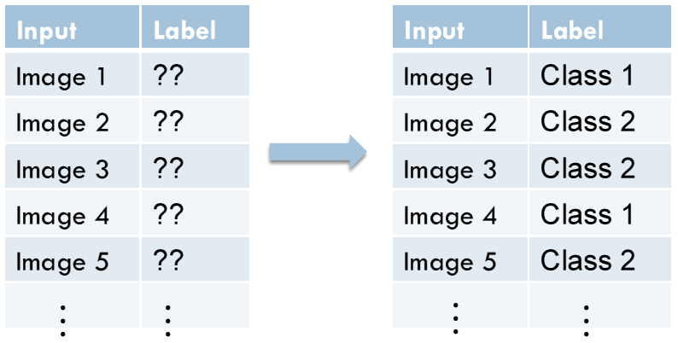
Learning Algorithm TYPES
Unsupervised
If the training data consist of input observations of unknown class
This is called clustering

Slide 6
Illustrating Classification Task
© Tan,Steinbach, Kumar Introduction to Data Mining 4/18/2004

Slide 7
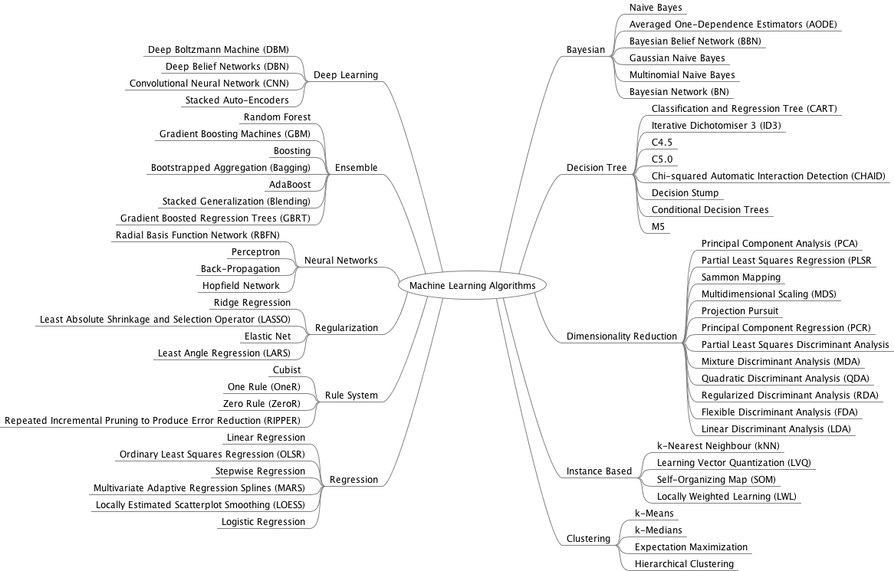
Mindmap By:
Dr. Jason Brownlee
2
4
1
5
3
Fuzzy Systems
6
Genetic Algorithms

Slide 8
Nearest Neighbor Classifier
Basic idea:
If it walks like a duck, quacks like a duck, then it’s probably a duck
Compute Distance
Test record
Choose k of the “nearest” records
Training records

Slide 9
Nearest-Neighbor Classifier
Requires three things
The set of stored records
Distance Metric to compute distance between records
The value of k, the number of nearest neighbors to retrieve
To classify an unknown record:
Compute distance to other training records
Identify k nearest neighbors
Use class labels of nearest neighbors to determine the class label of unknown record (e.g., by taking majority vote)

Slide 10
Definition of Nearest Neighbor
K-nearest neighbors of a record x are data points that have the k smallest distance to x

Slide 11
Nearest Neighbor Classification
Compute distance between two points:
Euclidean distance
Determine the class from nearest neighbor list
take the majority vote of class labels among the k-nearest neighbors
Weigh the vote according to distance
weight factor, w = 1/d²

Slide 12
k-Nearest Neighbor (k-NN) Algorithm
For every point in dataset:
calculate the distance between X and the current point
sort the distances in increasing order
take k items with lowest distances to X
find the majority class among these items
return the majority class as our prediction for the class of X

Slide 13
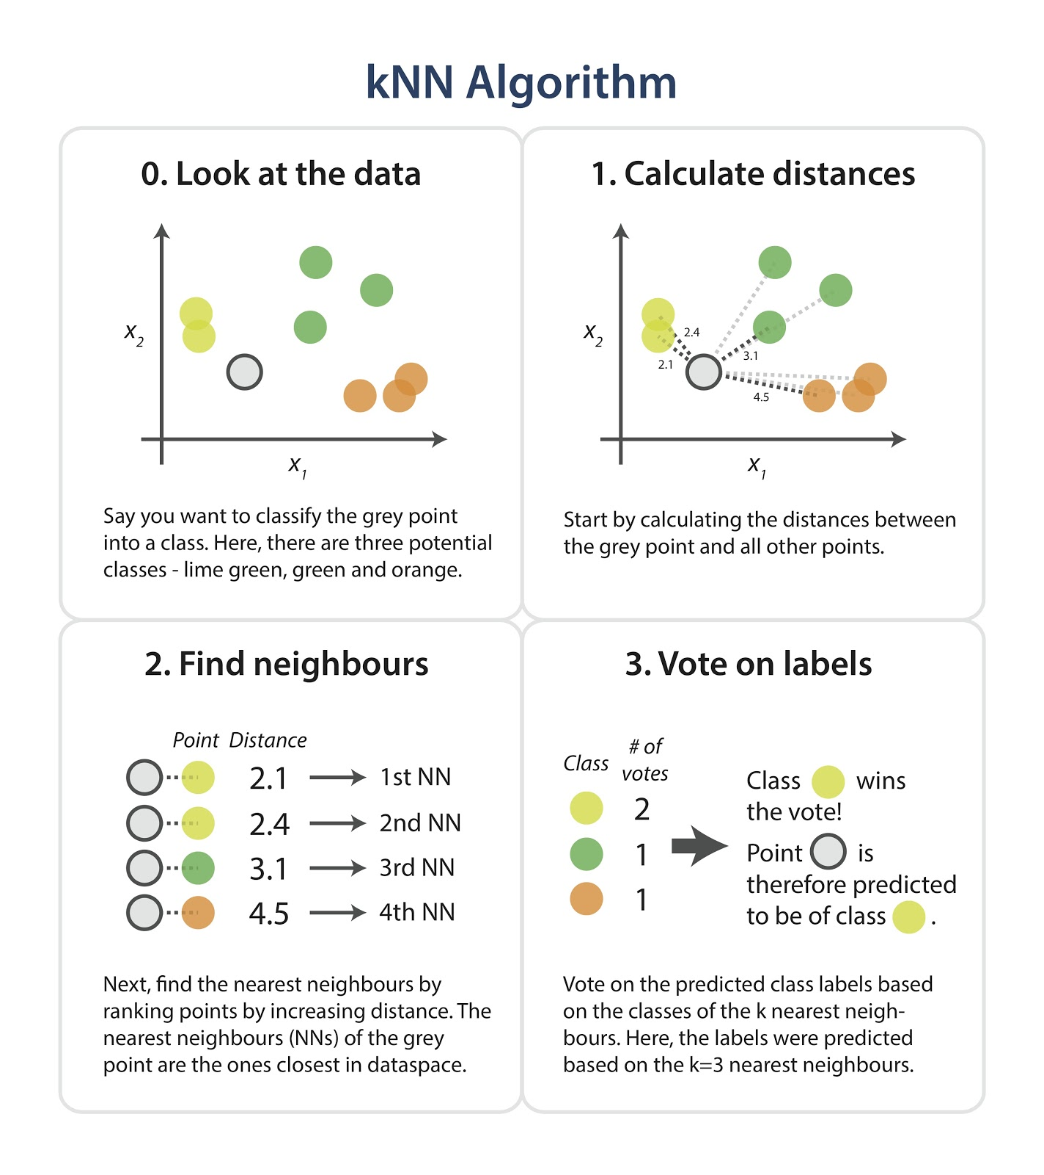

Slide 14
How to implement k-NN in Python
Handle Data: Open the dataset from CSV and split into test/train datasets.
Similarity: Calculate the distance between two data instances.
Neighbors: Locate k most similar data instances.
Response: getting the majority voted response from a number of neighbors.
Accuracy: Summarize the accuracy of predictions.
Main: Tie it all together.
https://machinelearningmastery.com/tutorial-to-implement-k-nearest-neighbors-in-python-from-scratch/

Slide 15
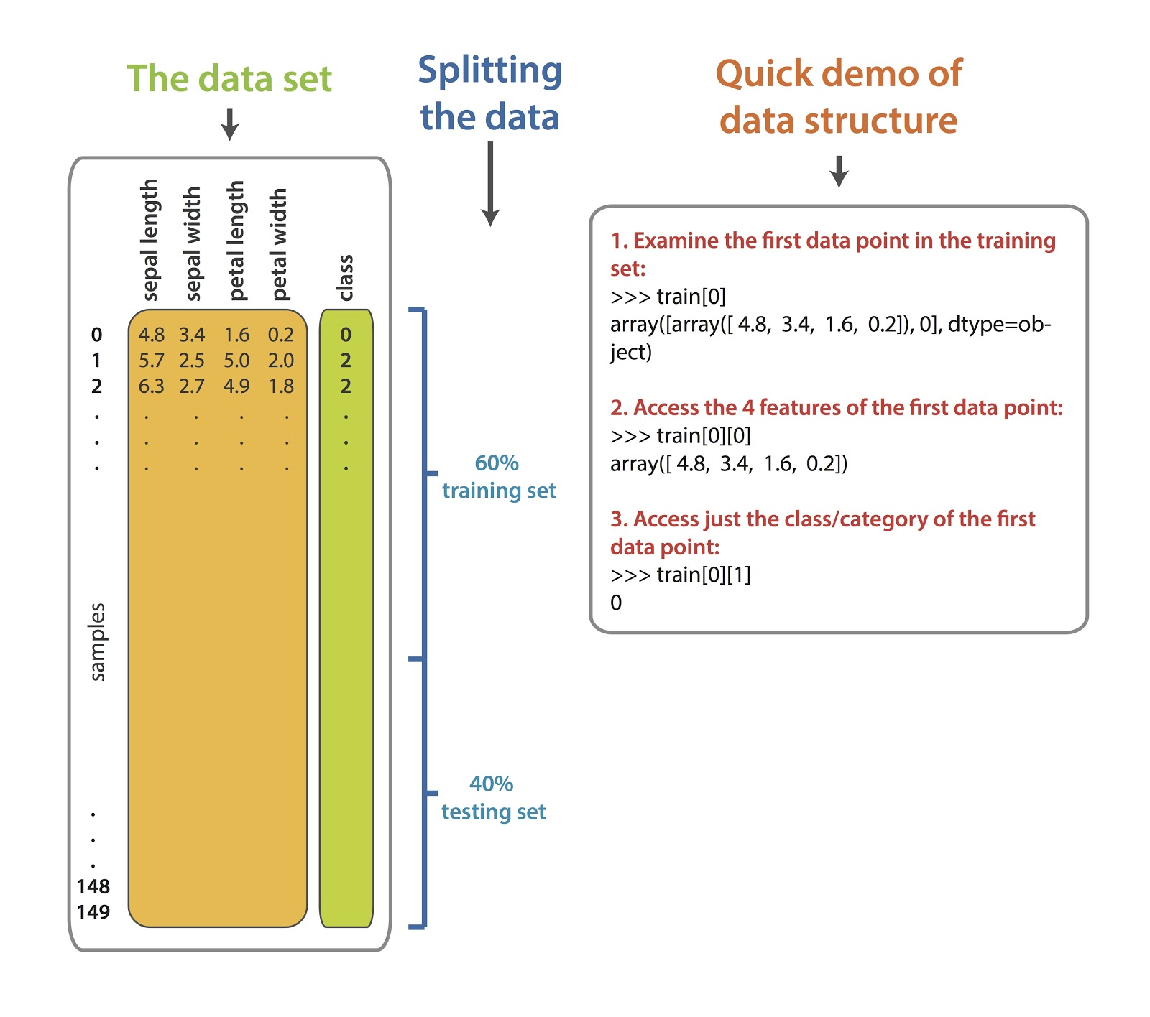

Slide 16
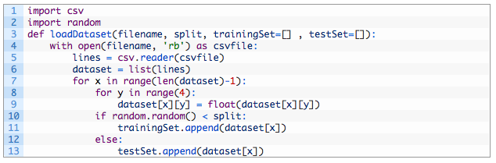
How to implement k-NN in Python
1. Handle Data: Open the dataset from CSV and split into test/train datasets.

Slide 17
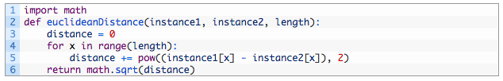
How to implement k-NN in Python
2. Similarity: Calculate the distance between two data instances.

Slide 18
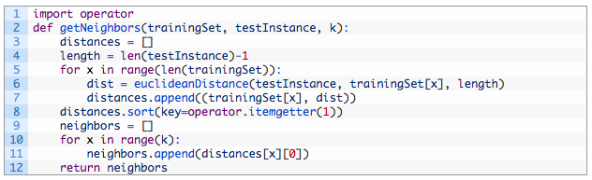
How to implement k-NN in Python
3. Neighbors: Locate k most similar data instances.

Slide 19
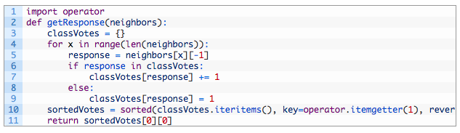
How to implement k-NN in Python
4. Response: a function for getting the majority voted response from a number of neighbors

Slide 20
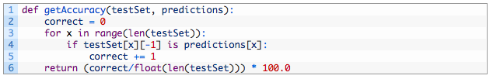
How to implement k-NN in Python
5. Accuracy: Summarize the accuracy of predictions

Slide 21
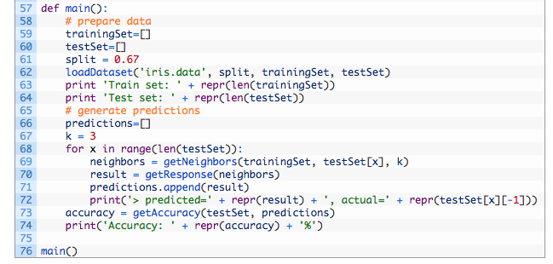
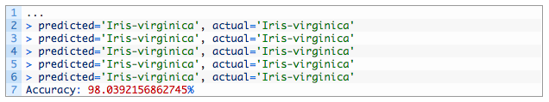
How to implement k-NN in Python

Slide 22
Nearest Neighbor Classification…
Choosing the value of k:
If k is too small, sensitive to noise points
If k is too large, neighborhood may include points from other classes

Slide 23
Nearest Neighbor Classification…
Scaling issues
Attributes may have to be scaled to prevent distance measures from being dominated by one of the attributes
Example:
height of a person may vary from 1.5m to 1.8m
weight of a person may vary from 90lb to 300lb
income of a person may vary from $10K to $1M

Slide 24
Nearest Neighbor Classification…
Problem with Euclidean measure:
High dimensional data
curse of dimensionality
Can produce counter-intuitive results
1 1 1 1 1 1 1 1 1 1 1 0
1 0 0 0 0 0 0 0 0 0 0 0
vs
0 1 1 1 1 1 1 1 1 1 1 1
0 0 0 0 0 0 0 0 0 0 0 1
d = 1.4142
d = 1.4142
Solution: Normalize the vectors to unit length

Slide 25
Other Distance Measures
Hamming Distance: Calculate the distance between binary vectors
Manhattan Distance: Calculate the distance between real vectors using the sum of their absolute difference. Also called City Block Distance
Minkowski Distance: Generalization of Euclidean and Manhattan distance

Slide 26
Nearest neighbor Classification…
k-NN classifiers are lazy learners
It does not build models explicitly
Unlike eager learners such as decision tree induction and rule-based systems
Classifying unknown records are relatively expensive

Slide 27
References
Tan, Steinbach, Kumar, Introduction to Data Mining, 2000
https://machinelearningmastery.com/k-nearest-neighbors-for-machine-learning/

Slide 28
What’s Next
More about UCI Machine Learning Dataset
More about Distance Measures
Exercises and Assignments

Slide 29
Tugas kNN
Buatlah sebuah program klasifikasi dengan metode k-nearest neighbor.
Program harus bisa membaca file dataset dari UCI machine learning databases:
https://archive.ics.uci.edu/ml/machine-learning-databases/spambase/
Gunakan metode pengukuran Cosine Similarity
Nilai K harus bisa bervariasi (menjadi parameter saat demo program)
Saat demo, data train dan test akan diberikan.
Setelah data train dan test diberikan, hitung nilai akurasi untuk data test dengan nilai K bervariasi, a.l: 1, 3, 5, 19.

